Slide 1

Code Refactoring and Bug Fixing

Slide 2
About me
I’m Shruti Chavan, Currently pursuing B.E in Computer Engineering from Pune Institute of Computer technology
Data enthusiast with a strong passion for data analysis and a commitment to continuous learning. Eager to leverage analytical skills to drive valuable insights and contribute to data-driven solutions.
Worked as Data Science Intern at QAAgility.
Linkedin: https://www.linkedin.com/in/shruti-c-bb2902212/
Github: https://github.com/Shrutic-24

Slide 3
Agenda (This should be the PPT flow)
The key Objective of the project include:
Refactoring the existing codebase to improve its structure, readability, and maintainability.
Identifying and fixing bugs within the application, particularly those affecting its functionality.
Ensuring the Note Taking Application work seamlessly as intended
Documenting all identified bugs along with the approach used to resolve the bug, providing clear and comprehensive documentation.

Slide 4
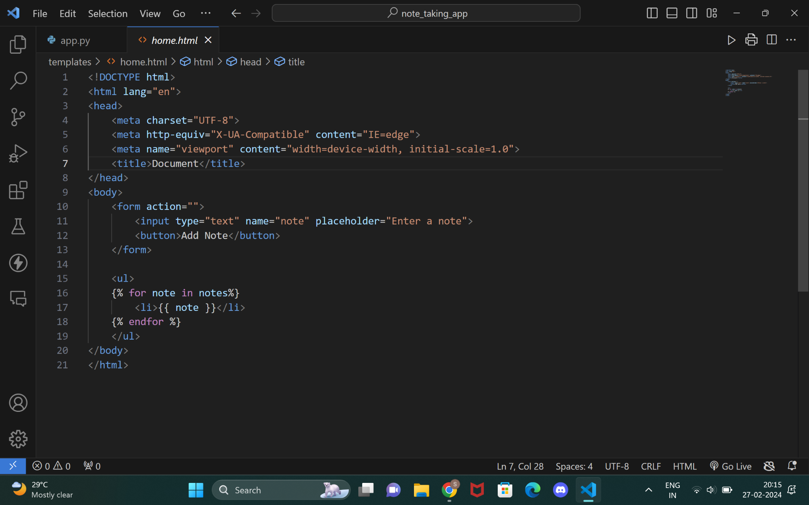
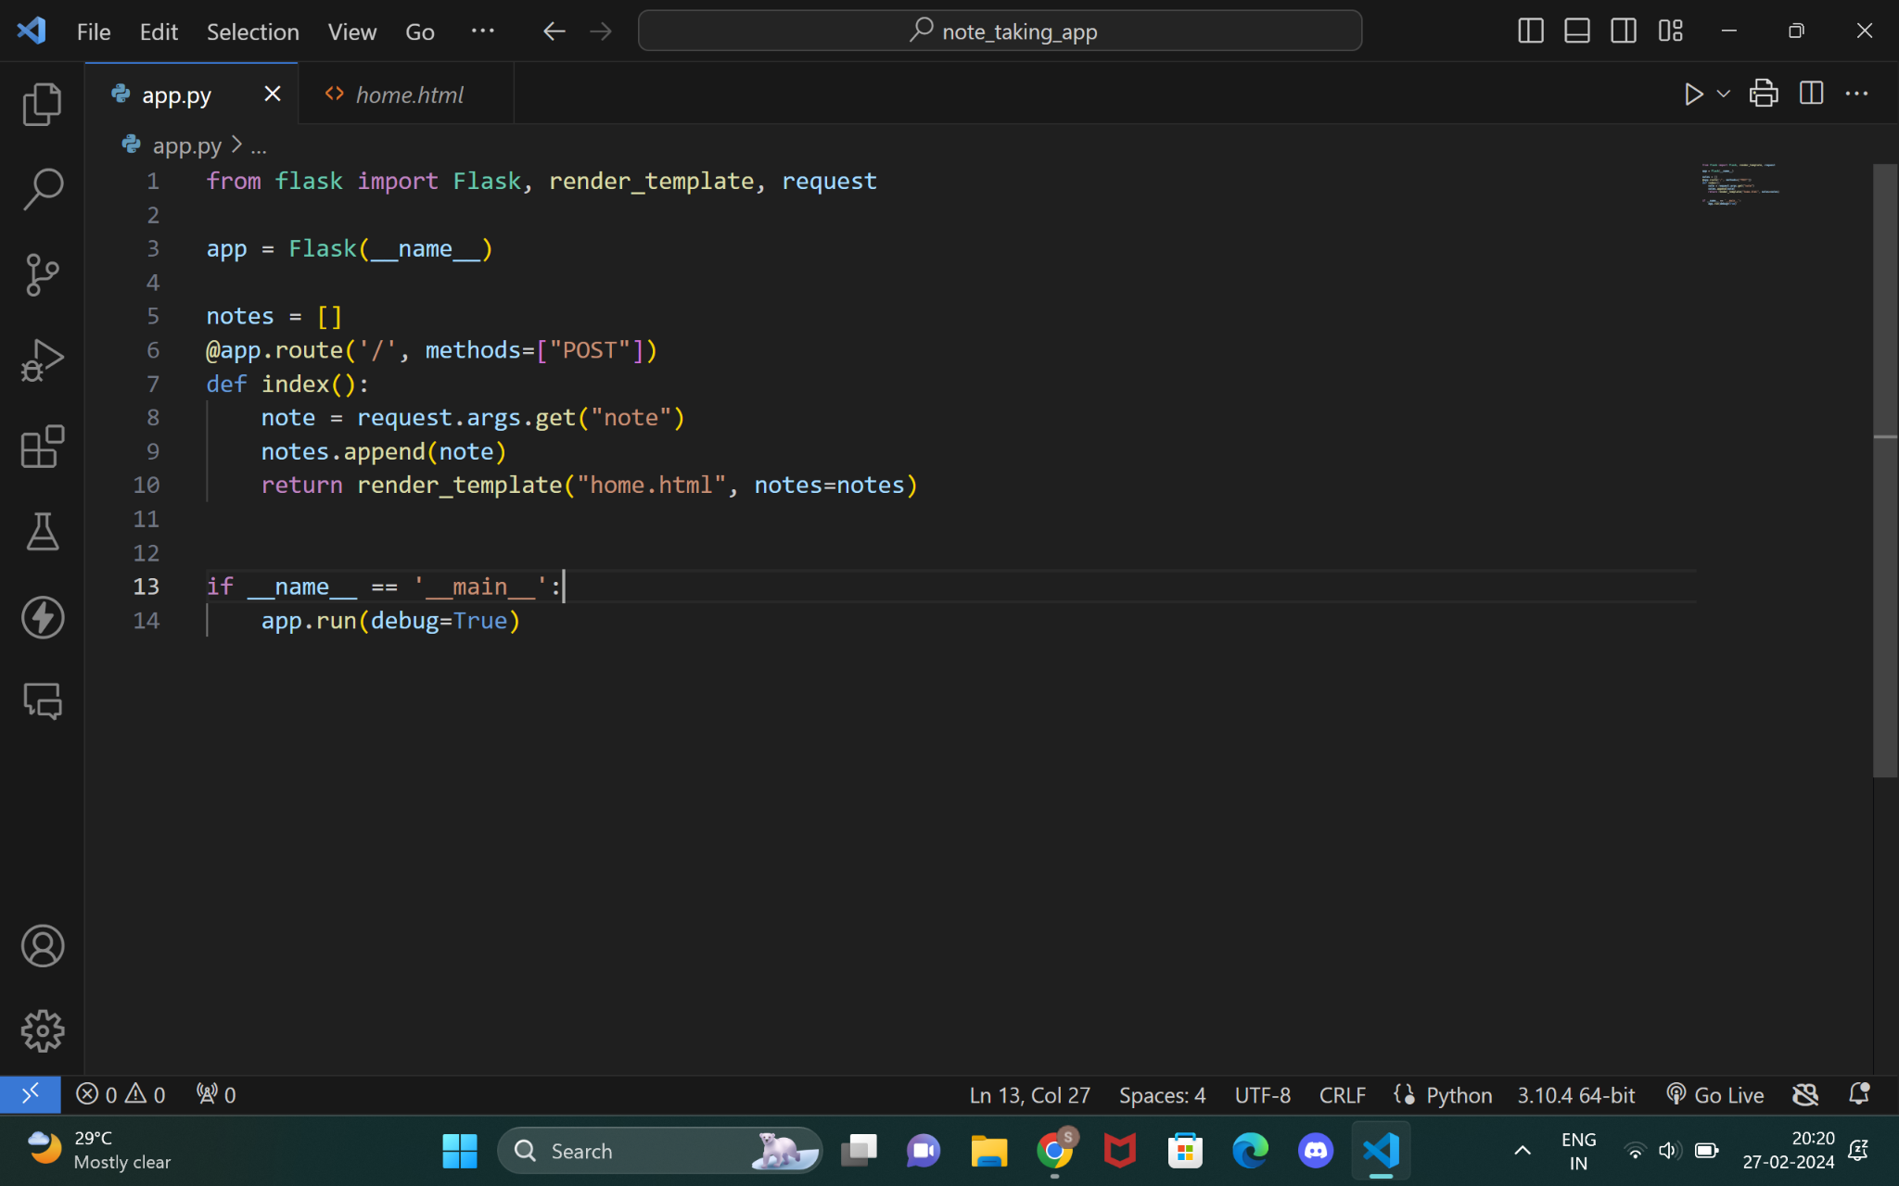
Bugs and Resolution Approaches
The following code snippet contains initial Application , which contains identifiable Bugs impacting its functionality.
HTML Code:
Flask Code:

Slide 5
Bug 1: Form Action and Method
Description: In HTML form, the action attribute of the form tag is missing. Without specifying an action, the form will default to submitting to the current URL, which in this case may not be what's intended.
Resolution Approach:
Added action="/" to the <form> tag to specify the URL where the form data should be submitted.
Specified method="POST" in the <form> tag to ensure that form data is sent using the POST method.
<form action="/" method="POST">

Slide 6
Bug 2: Submit Button Type
Description: In HTML form, the submit button should be of type submit to trigger the form submission.
Resolution Approach:
Changed the button type to type="submit" to ensure that clicking the button triggers the form submission.
<button type="submit">Add Note</button>

Slide 7
Bug 3: Handling Form Submission
Description: In the Flask route /, the method is set to POST, but the form in the HTML does not specify a method. By default, forms use the GET method if not specified, which means the Flask route won't capture the form data properly.
Resolution Approach:
Modified the route decorator to accept both GET and POST requests by specifying methods=["GET", "POST"].
Added a conditional statement to check if the request method is POST.
Extracted the note from the form using request.form.get("note").
@app.route('/', methods=["GET","POST"])
def index():
if request.method == "POST":
note = request.form.get("note")
if note:
notes.append(note)
return render_template("home.html", notes=notes)

Slide 8
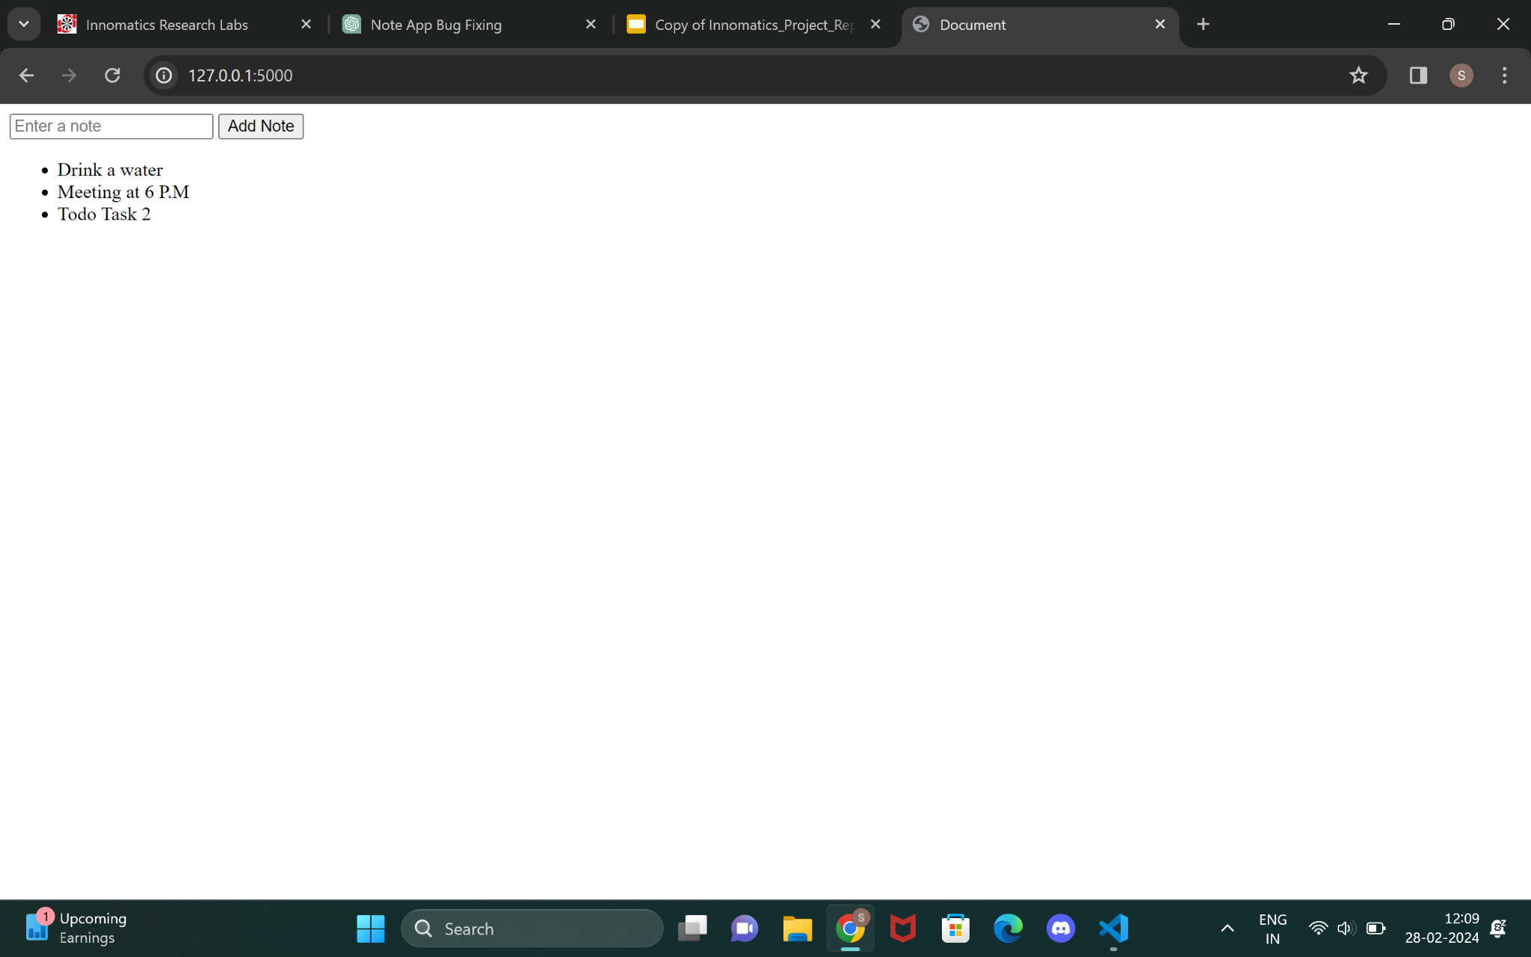
Working application after Debugging and code fixing:
Conclusion:
The solution ensures that the form properly submits data to the Flask application using the POST method. It retrieves the submitted note from the form and appends it to the list of notes. The updated list of notes is then passed to the HTML template for rendering. By addressing these issues, the Note Taking Application should now function as intended, allowing users to add notes and see them displayed on the same page.

Slide 9

THANK YOU

